Slide 1
Liquid level recognition

Slide 2
Content
Problem
Dataset
Pixel Per Metric (PPM)
Camera calibration
Final results

Slide 3
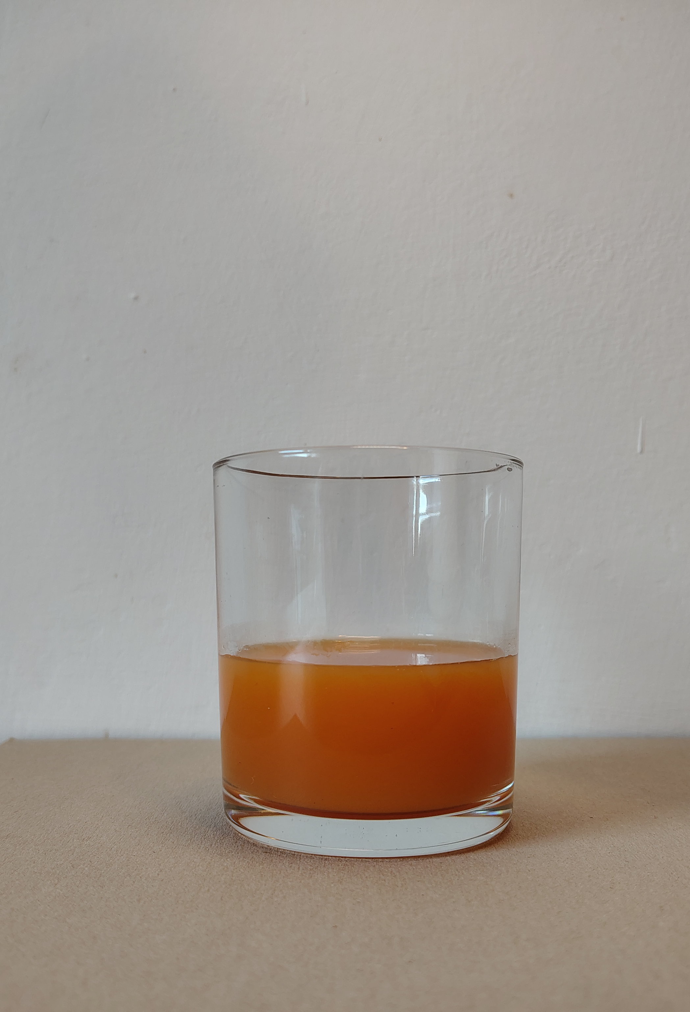
The problem we aimed to tackle is the accurate measurement of liquid height in a transparent glass, based only on an image.
3
Problem
Notes:
Problem
non-intrusive method concept
Pratical things:
Beverage industry
Medical industry

Slide 4
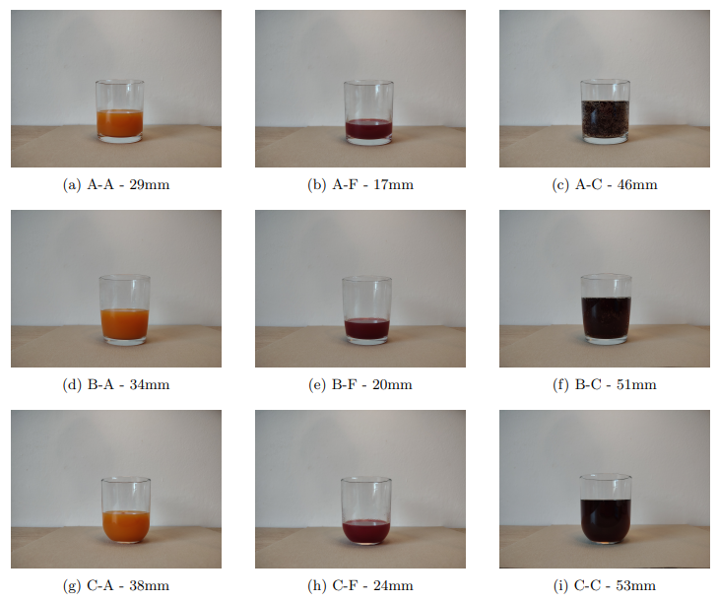
Dataset
Notes:
X – Y letters
Consistent Camera Angles
Uniform Lighting Conditions
Neutral Background Selection
Multiple Liquid Types for Robustness
Consistent Distance and Framing (for PPM)

Slide 5
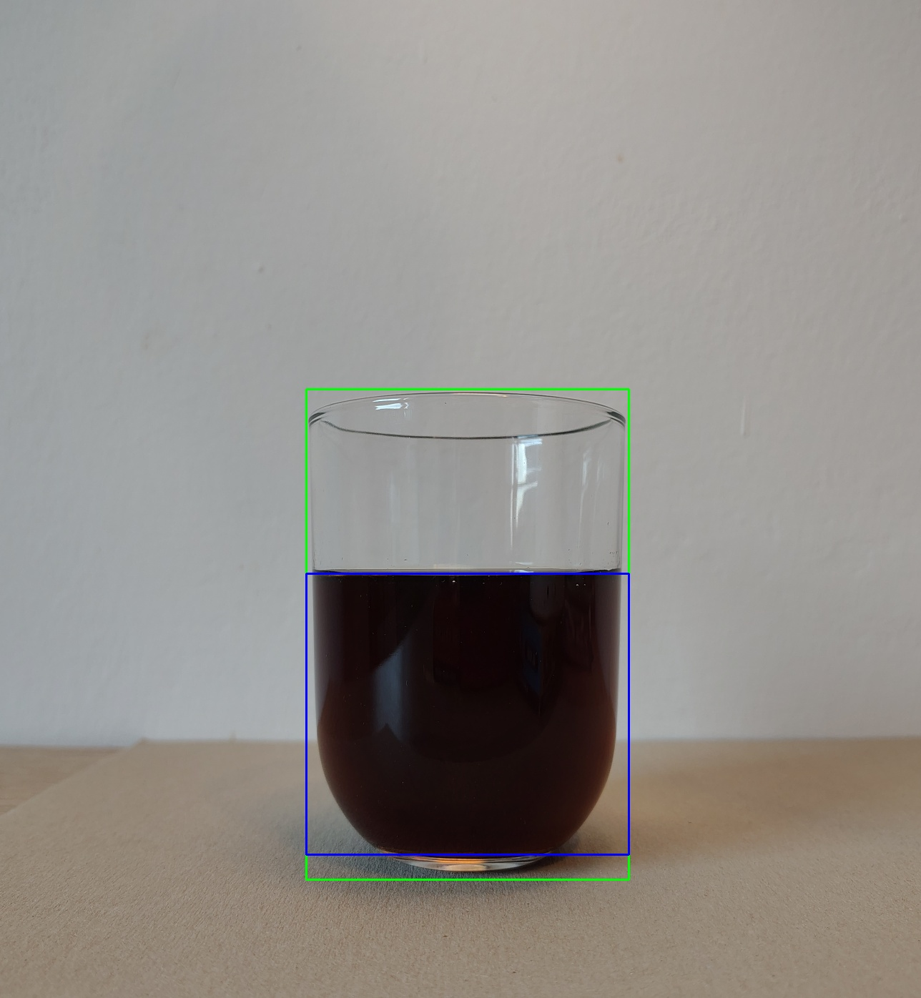
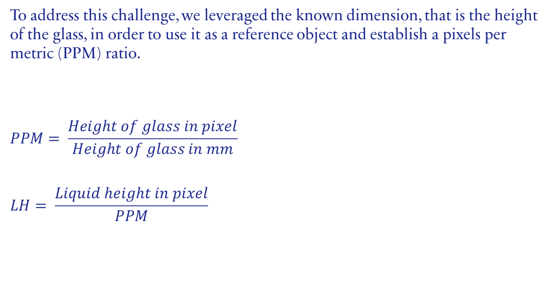
Idea
To address this challenge, we leveraged the known dimension, that is the height of the glass, in order to use it as a reference object and establish a pixels per metric (PPM) ratio.
$$PPM= \frac{Height of glass in pixel}{Height of glass in mm}$$
$$LH= \frac{Liquid height in pixel}{PPM}$$

Slide 6
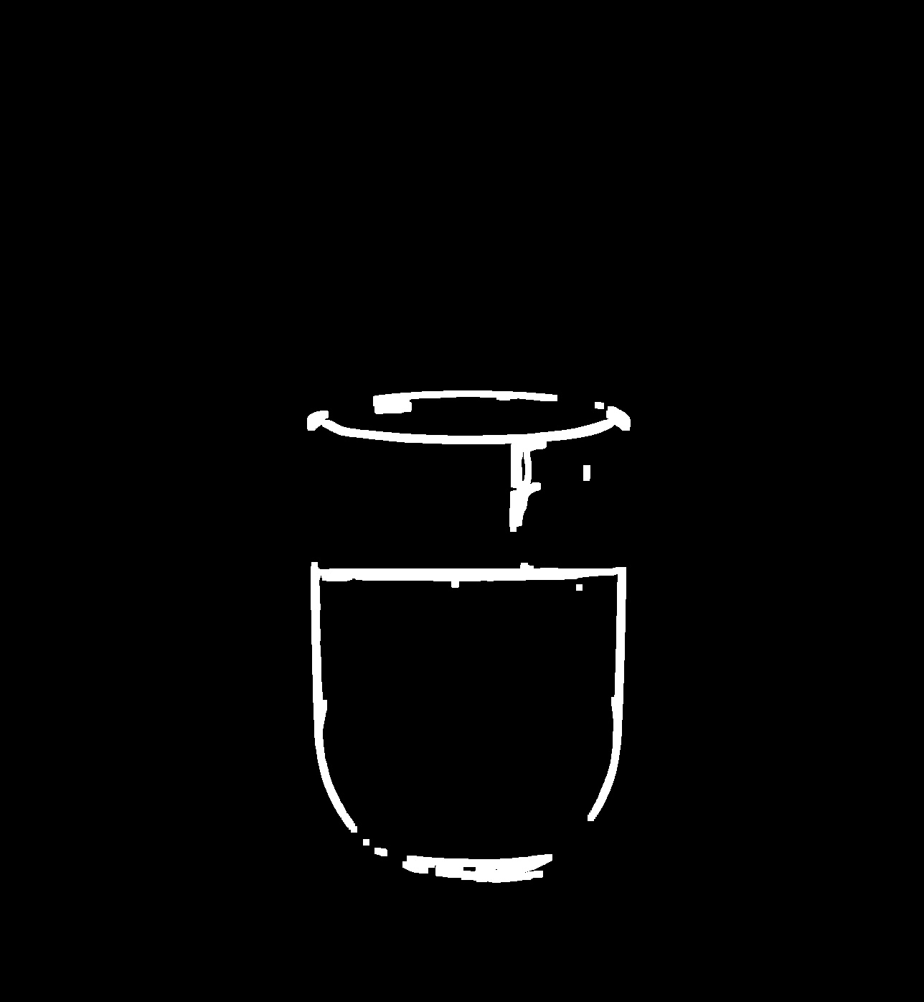
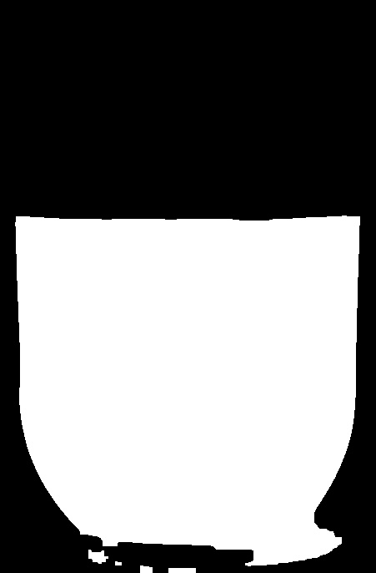
Workflow
Apply Gaussian filter
Glass handling:
Detect glass edges
Detect glass contours
Reduce the area of the image to handle liquid
Detect liquid edges
Detect liquid contours
Apply PPM

Slide 7
improvements
Camera calibration
Noise reduction and background filtering

Slide 8
CAMERA CALIBRATION
Camera calibration consists in estimating all the necessary intrinsic and extrinsic parameters required to avoid distortion in the captured images.
Intrinsic parameters:
Focal length
Optical center
Radial and tangential distortion coefficients of the lens
Extrinsic parameters:
Rotation matrix
Translation vector

Slide 9
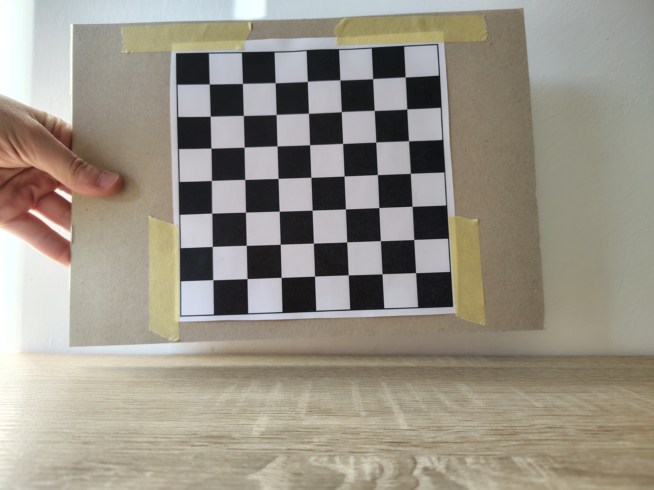
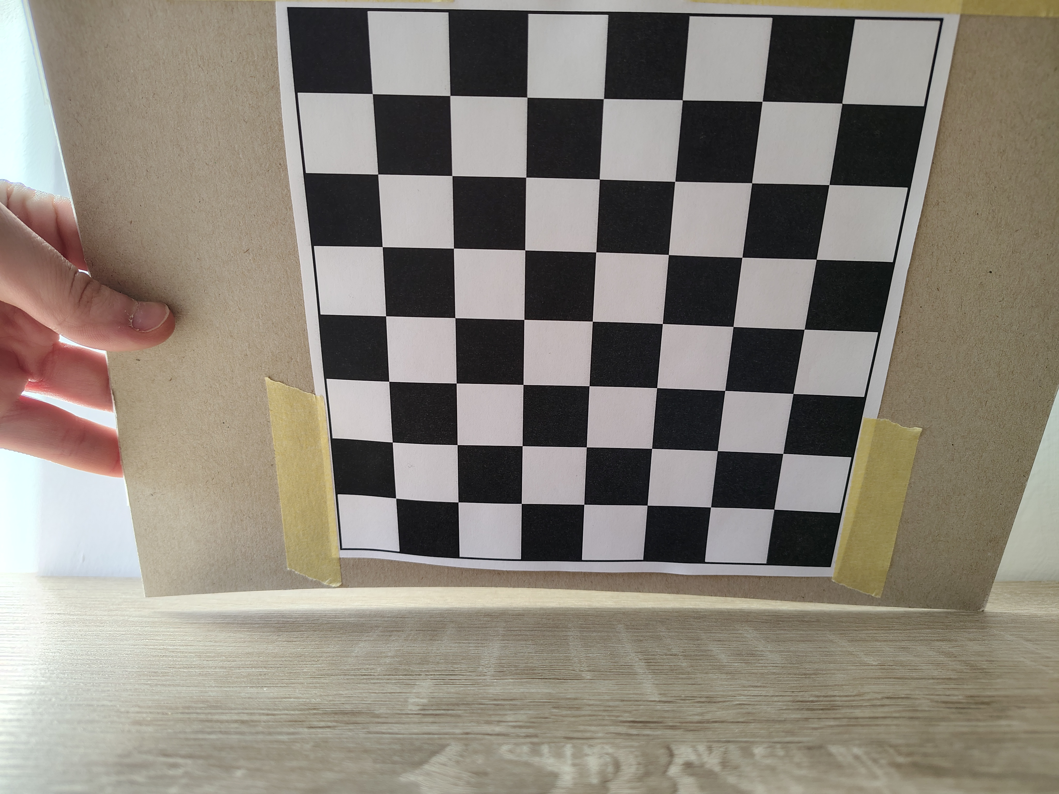
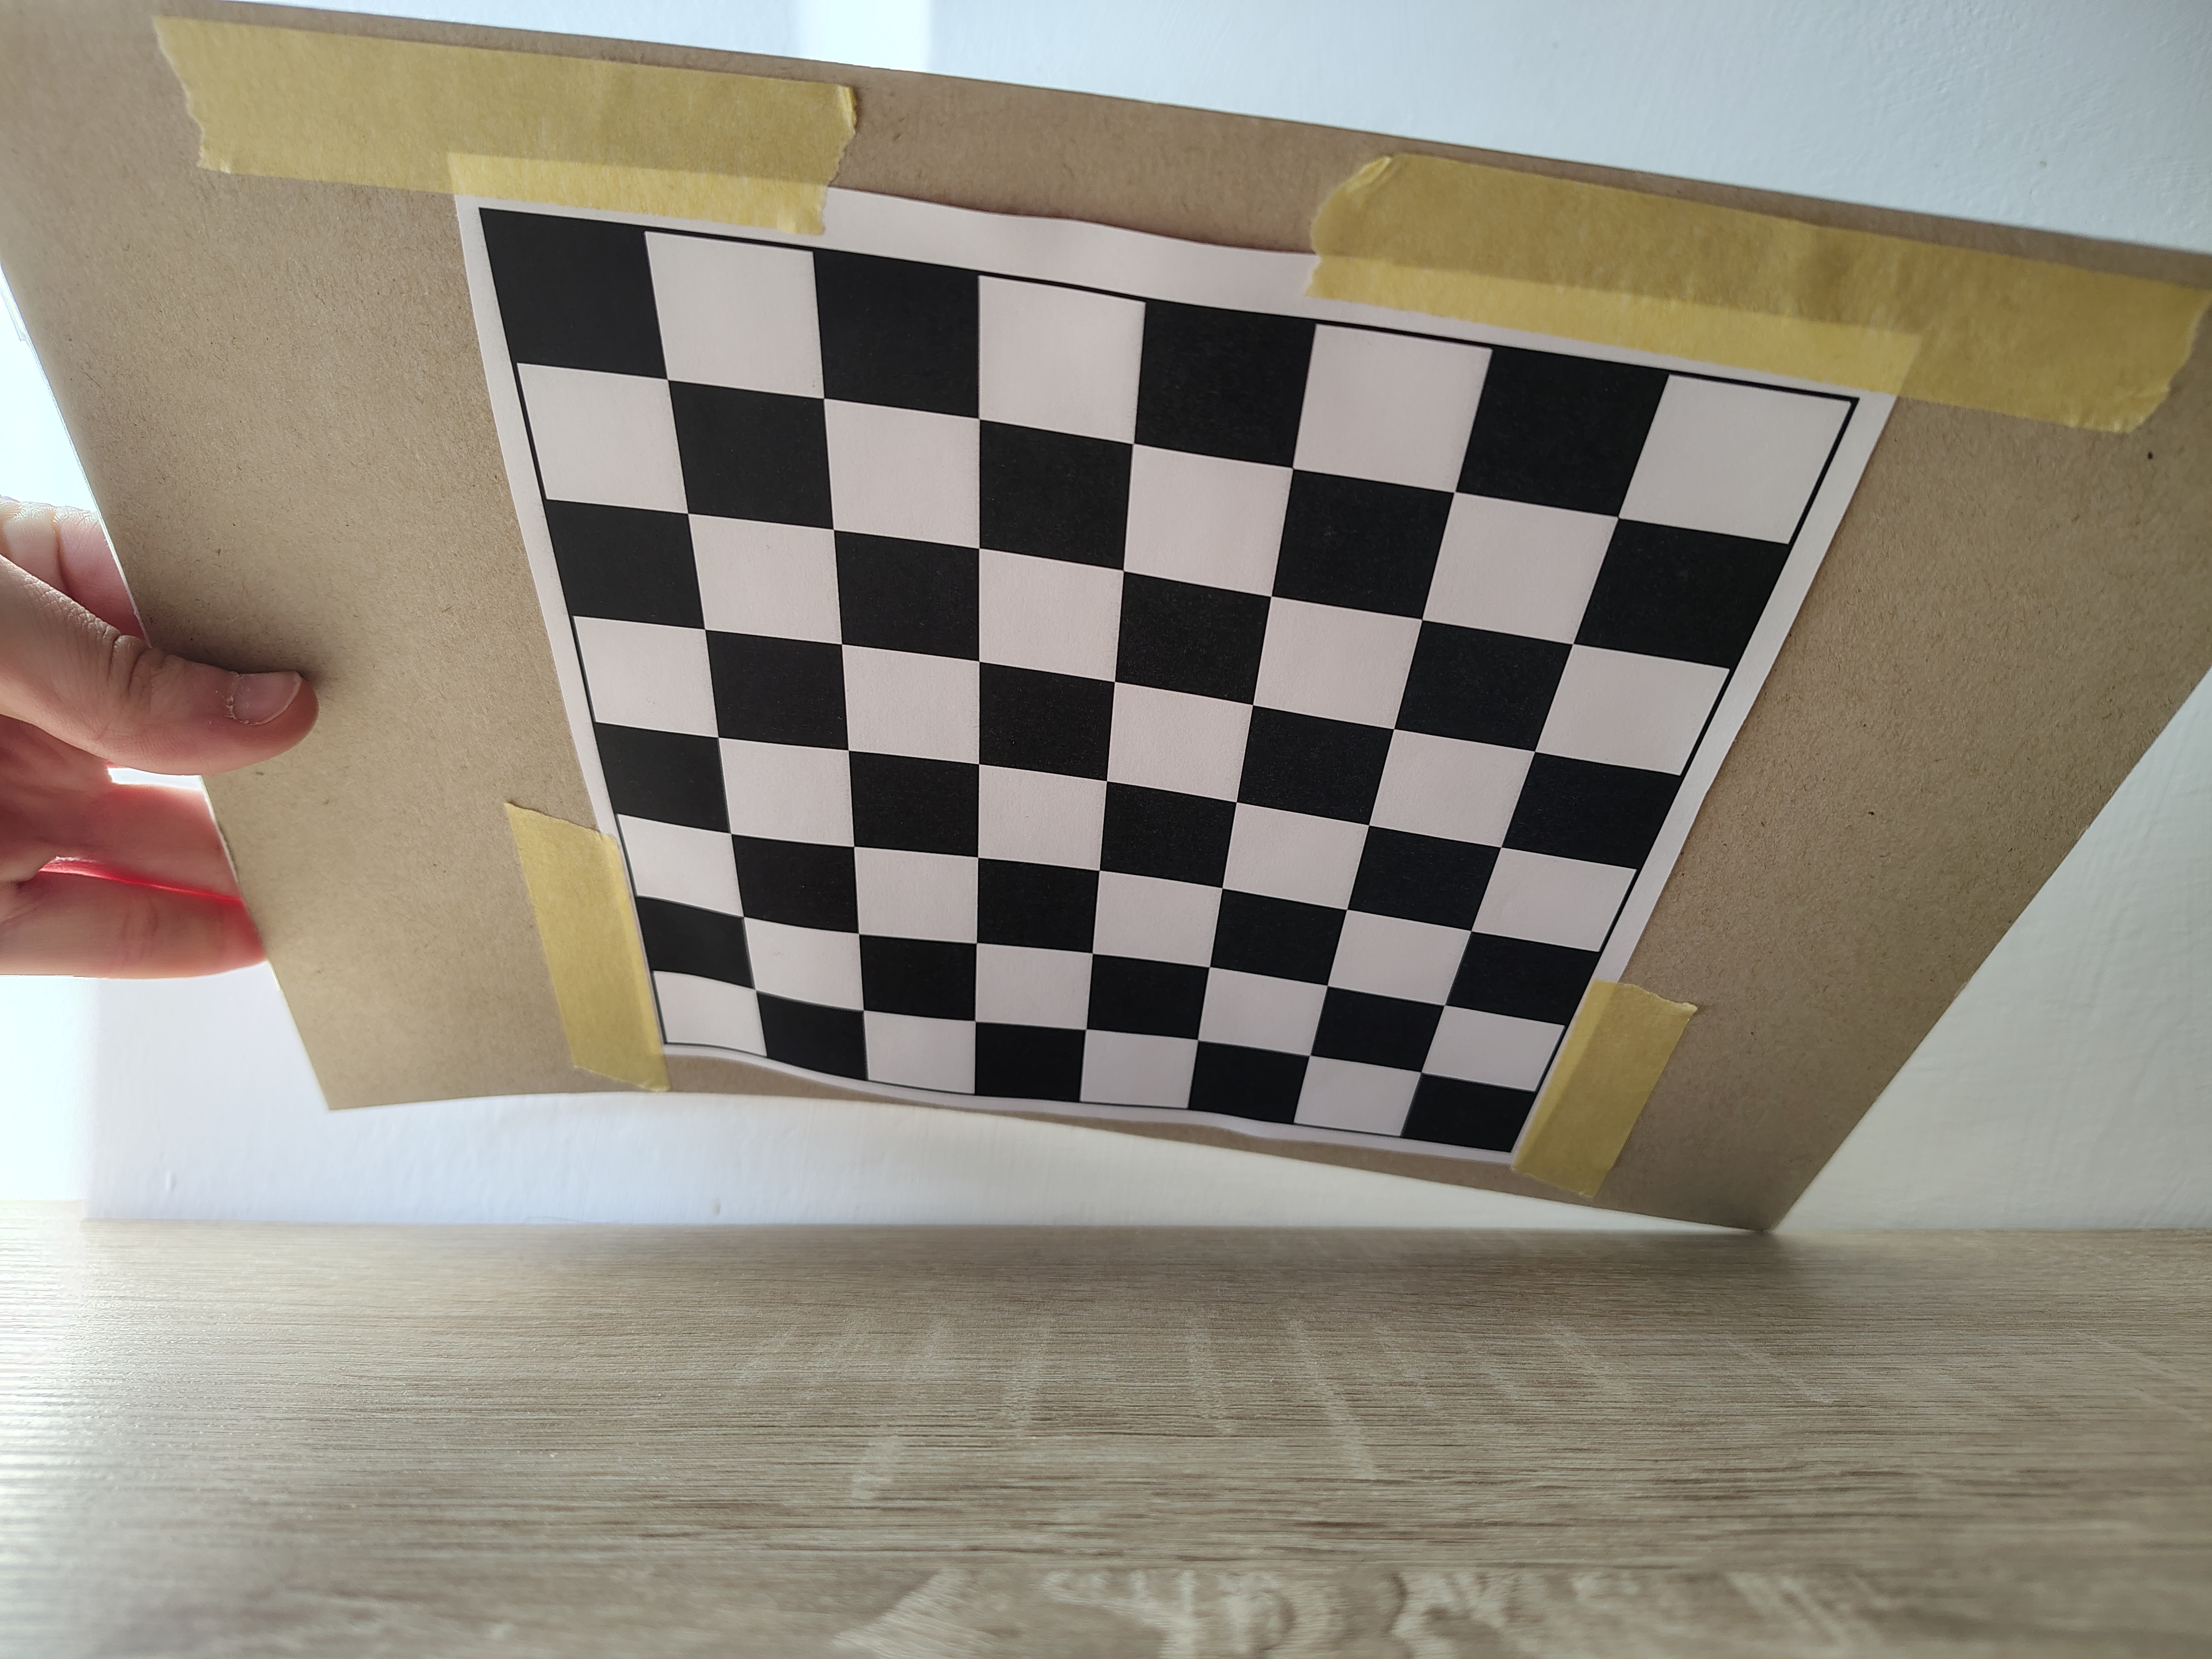
Method used
To accurately calibrate the camera, we capture multiple images of the checkerboard pattern from different viewpoints.
The camera remains stationary, while the checkerboard is moved to different orientations.

Slide 10
Noise reduction and background filtering
We applied more preprocessing techniques to improve our result:
Thresholding (Otsu’s Method) Converts the image into a binary mask.
Morphological Operations Helps refine the object’s contour.
Adaptive Thresholding Useful for varying lighting conditions
Notes:
Otsu’s method (intra-class)
Morphological (OPEN, CLOSE)
Adaptive (Percentile)

Slide 11
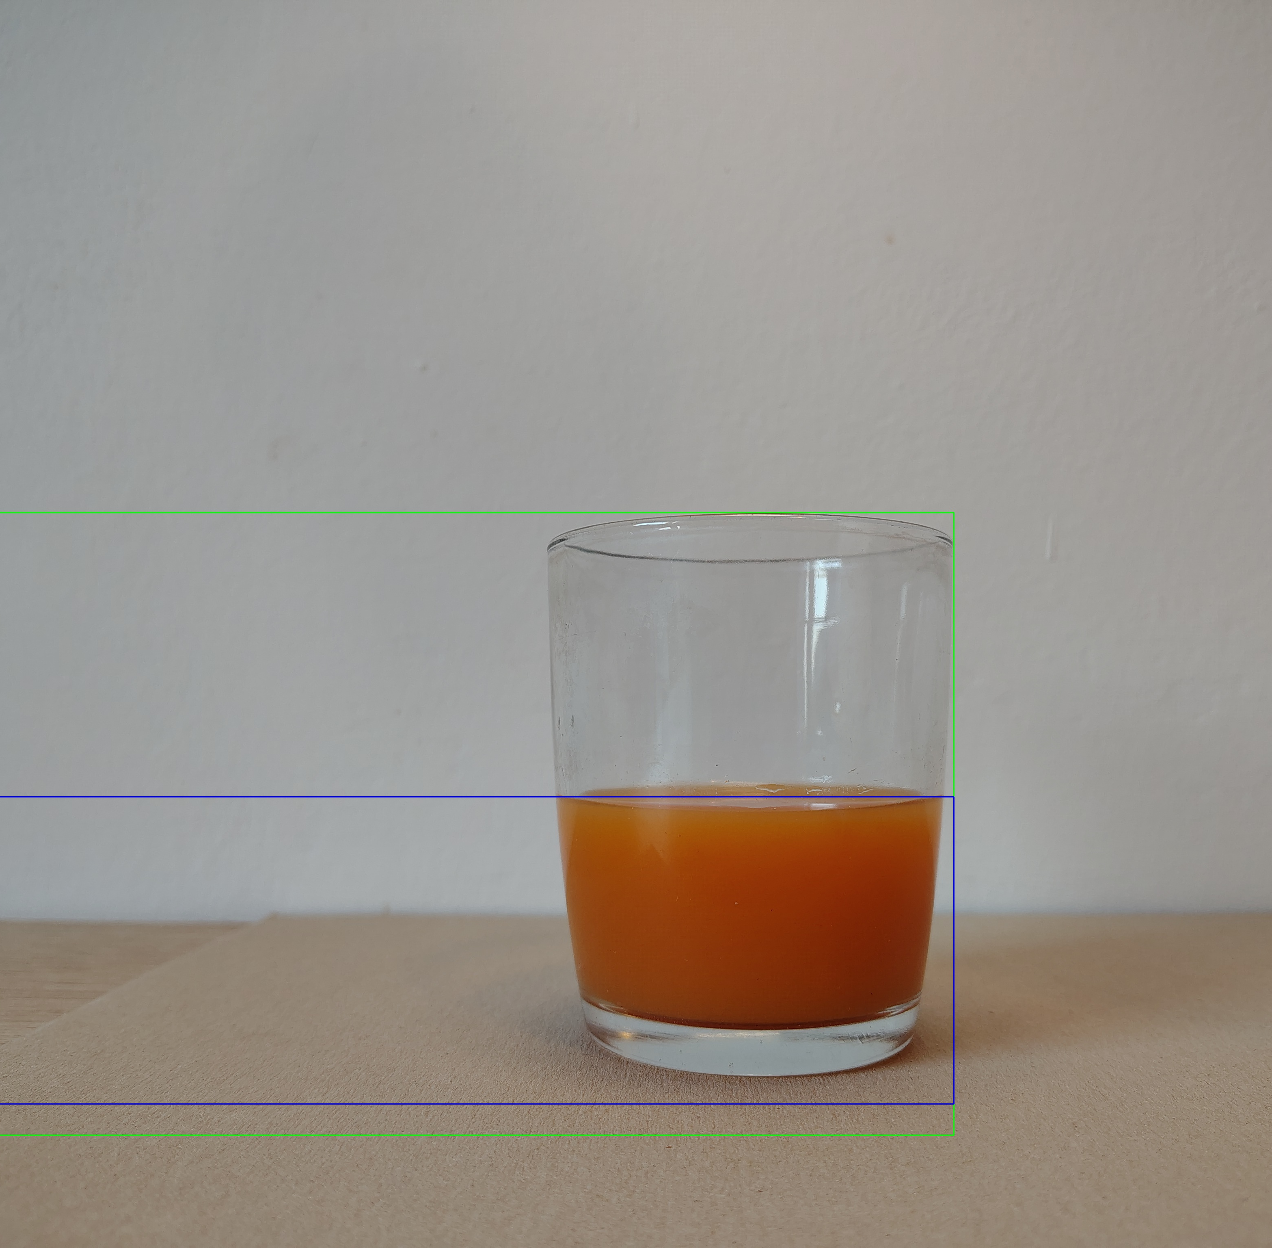
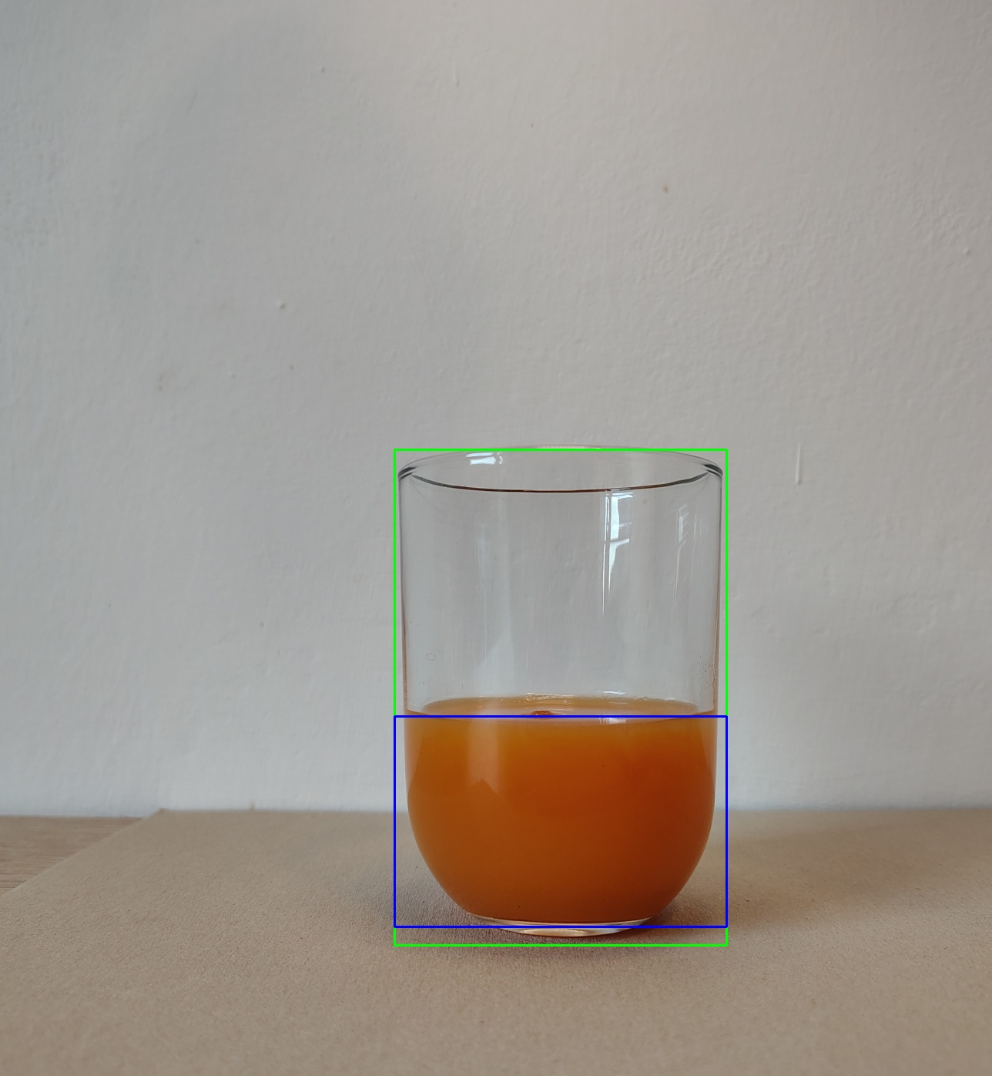
Before - after

Slide 12
Thanks Q&A
Donald Gera
Alessandro Moscatelli

